Slide 1
I-9 & E-Verify Audit
All Diocesan Parishes and Schools
Updated: 11/29/23
Notes:
We have some very important topics to cover today, so we really appreciate your time and attention for the next half hour or so.
Today, we will be discussing the I-9 and E-Verify processes in ADP. Let’s first discuss why we brought you all together and why this is such an important topic. With ADP, employees can only be E-Verified with electronic I-9s. This means that all aspects of both the I-9 and E-Verify process now take place in ADP.

Slide 2
Intro to I-9 & E-Verify in ADP
I-9 & E-Verify process is now completely electronic
Process occurs in ADP
Compliance
You are responsible for working with the employee to complete all steps of I-9 and E-Verify process.
Notes:
We felt it was very important to meet about this because, as of today, more than half of the people you have collectively entered as new hires since moving to ADP, are still not in compliance with this requirement.
We have contacted a lot of you about this process leading up to today’s meeting and have discovered some misconceptions about how the process is now handled.
As part of your job duties, you are responsible for working with the employee to help them complete their portion of the I-9 form, completing your own portion, and then submitting the form to E-Verify and ensuring the E-Verification case is closed.
As you might remember, we talked about this during our trainings at the beginning of the year and we also sent out the PDF guide for this process. We understand that this was a lot to take on when first moving to ADP and learning payroll, so we thought now would be a good time to reapproach this topic.
We recently ran an audit, which revealed that many employees have not had this process completed, so now that things have settled into a groove and you’ve all better adapted to ADP, it’s time to bring this area of compliance back where it needs to be.

Slide 3
Definitions
I-9 = the form used to verify the identity and employment authorization of individuals hired in the U.S. Consists of information from the employee (“Section one”) and employer (“Section Two”).
E-Verify = an internet-based system that compares the information from Form I-9 with records available at the U.S. Dept. of Homeland Security (DHS) and Social Security Administration (SSA). If the information from the form matches DHS and SSA records, then the employee is authorized to work in the U.S.
Notes:
As a reminder, the Form I-9 is used to verify the identity and employment authorization of individuals hired in the U.S.
It consists of information from the employee (which ADP refers to as “Section one”) and information from the employer (which ADP refers to as “Section Two”).
E-Verify is an internet-based system that compares the information from the Form I-9 with records available at the U.S. Dept. of Homeland Security and Social Security Administration.
If the information from the form matches their records, then the employee is authorized to work in the U.S.

Slide 4
I-9 & E-Verify Basics
Importance of completing I-9 and E-Verify by 3rd day of work
Failure to comply could result in hefty fines
Visualizing former paper form process and how it relates to the electronic form
Notes:
We will continue to recap some basics and then discuss how you can view a list of the employees you need to correct.
All employees are required to be E-Verified within three days of hire. Failure to do either portion in a timely manner could result in very hefty fines if US Customs and Immigration Services were to audit you.
If you remember completing the paper I-9 form prior to this year, “section one” is the first page where the employee states their identity, and “section two” is the second page where you physically reviewed and filled in the employee’s proof of identity and work authorization document information.
In ADP, the I-9 form is nearly identical, just electronic instead.

Slide 5
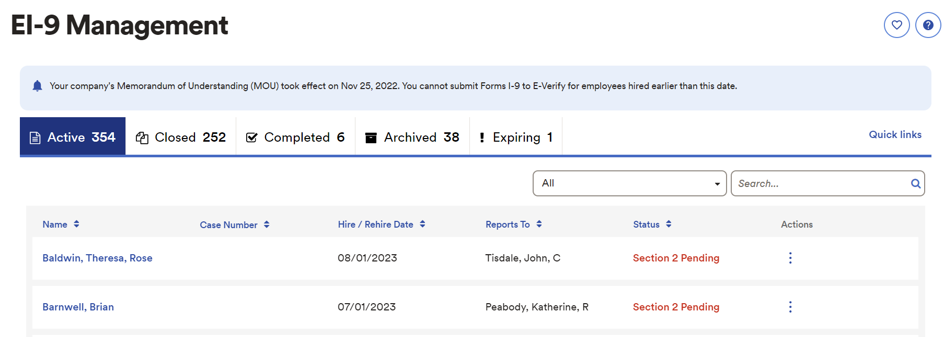
Correcting Deficiencies
Go to: Process > HR > E I-9 Management
Notes:
So now, I’m going to show you how to review and correct I-9 deficiencies. If you are at your computer, please feel free to take these steps while I guide you through.
You can navigate there by going to Process, HR, and EI-9 management. You’ll see these steps written down on this slide too, for future reference.
On the EI-9 management screen, you can see a list of everyone that you need to correct. So, everyone you see under the Active section has not completed the I-9 Process successfully. As you can see, we currently have 354 folks out of compliance total.
Our goal is to have no one remaining in this section.
Please note that you can also see the status of the employee’s I-9 over to the right, which is important to pay attention to.

Slide 6
Types of Deficiencies
Section One Pending = entire process incomplete
Section Two Pending = employer portion incomplete and not E-Verified
E-Verify Pending = employer still needs to sign and submit
Paper Form = no longer permitted
Unable to E-Verify with a paper form
How to change from Paper Form to Electronic in ADP
Notes:
We will now go over the Different types of Deficiencies
Section 1 pending means the employee has not completed their portion of the I-9 and you can’t move forward until they do so.
If it says section 2 pending, the employee completed their portion, but you never completed the “section 2” of the I-9, or E-Verified them.
If the status says E-Verify Pending, then you completed the second portion, but stopped before you completed the E-Verify.
To determine what needs to be done, you’ll need to click on the three dots to the right of their name in the EI-9 Management screen and you’ll see the available options to proceed.
If it says Paper Form, this means that you mistakenly chose “Paper Form” during the new hire process. Many of you may have previously been unaware of this process, so we need to ensure that you’re not simply completing the paper I-9 form and filing it away without any sort of E-Verification step.
We absolutely HAVE TO reiterate that paper forms are not permitted any longer, primarily because they give you no avenue to complete the E-verify process.
The person can only be E-Verified if an Electronic I-9 is sent to USCIS through the ADP platform. So, if you previously selected the paper form in ADP with new hires, you will need to change them to electronic so that you can get everyone E-Verified. You can do that by clicking on the three dots to the right of their name and selecting “change paper to electronic”. This will then recategorize them as Section 1 pending, and you can start from there. We will have screenshots in the coming slides so you can get more of a visual understanding.

Slide 7
Correcting Deficiencies
Notes:
Correcting Deficiencies
Once your employee has been E-Verified, they will be moved into the closed tab, which you see here to the left, and then you will see the E-Verification confirmation and case number populate as well.
Again, the end goal is to have zero people in the active tab.
I should also note that we will send out this presentation later today, which has step-by-step instructions on how to resolve various issues.
In the next few slides, we will briefly discuss some of what you may encounter.

Slide 8
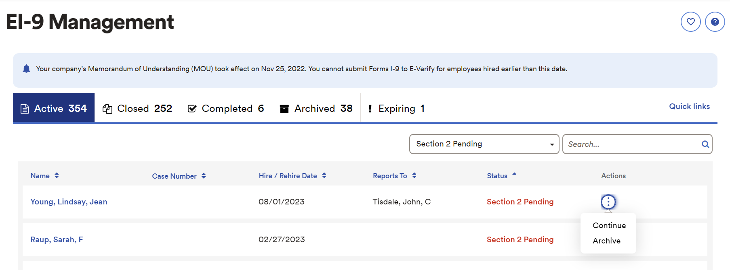
Correcting Deficiencies
Notes:
For statuses that say section 2 pending or E-Verify pending, you’ll need to select the 3 dots, click continue, and proceed with the final steps until you see the E-Verify confirmation.

Slide 9
E-Verify Training in ADP
Training Link Here
Notes:
Now might also be a good time to mention that if you have not E-Verified an employee through ADP before, you will first be required to complete a training through the portal.
A link to the training will appear here at the top of the EI-9 management page. The training itself is about 45 minutes, and you need to pass the quiz with at least an 80% before you can E-Verify employees.
I would highly recommend taking notes during the training, even if you already feel you have a good comfort level in this area.
You can then E-Verify employees after you pass the quiz.

Slide 10
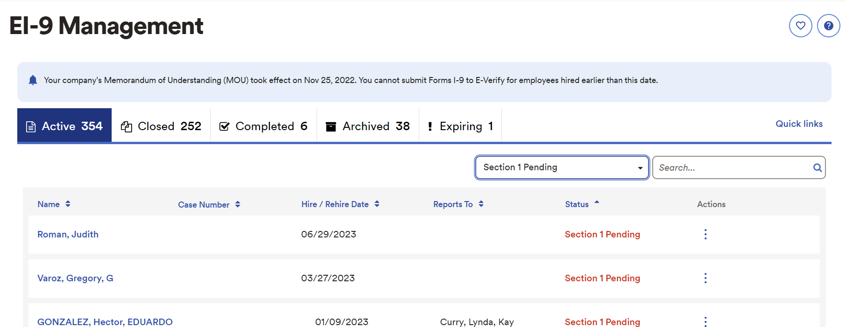
Section 1 Pending
Notes:
So now we can circle back to the different statuses on this screen.
If you see section 1 pending, please remind the employee to complete their portion because with this status, you can’t move forward. If they need assistance with this process, there is a step-by-step guide in the new hire paperwork packet on our website.
I also need to mention a new aspect of this process, called the onboarding experience. I’ll give you the background to help you understand the full picture.
The employee portion of the I-9 is part of the “onboarding experience”. All employees need to be assigned the “onboarding experience” within their first 30 days to be able to complete their I-9.
Luckily, they are automatically assigned Onboarding when you use the new hire template when hiring them in payroll.
Since the vast majority of Section 1 Pending folks were hired a long time ago, you’ll need to extend the onboarding for the person and tell them to complete section 1.

Slide 11
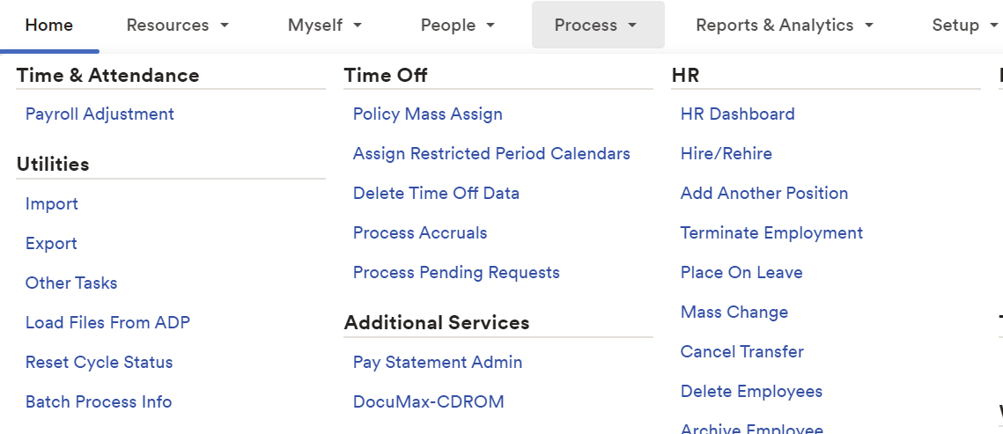
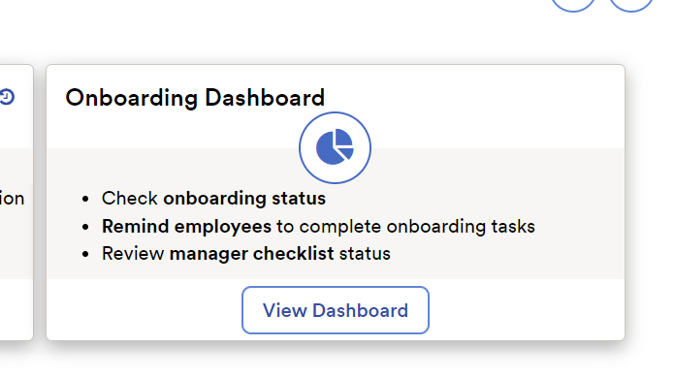
Onboarding Dashboard
1. Go to: Process> HR > Hire/Rehire
2. Click ‘View Dashboard’
Notes:
To extend onboarding, you’ll need to go to the Onboarding Dashboard.
To get there, you can go to process, HR, Hire/Rehire, and View Dashboard, which is shown here in steps 1 and 2.

Slide 12
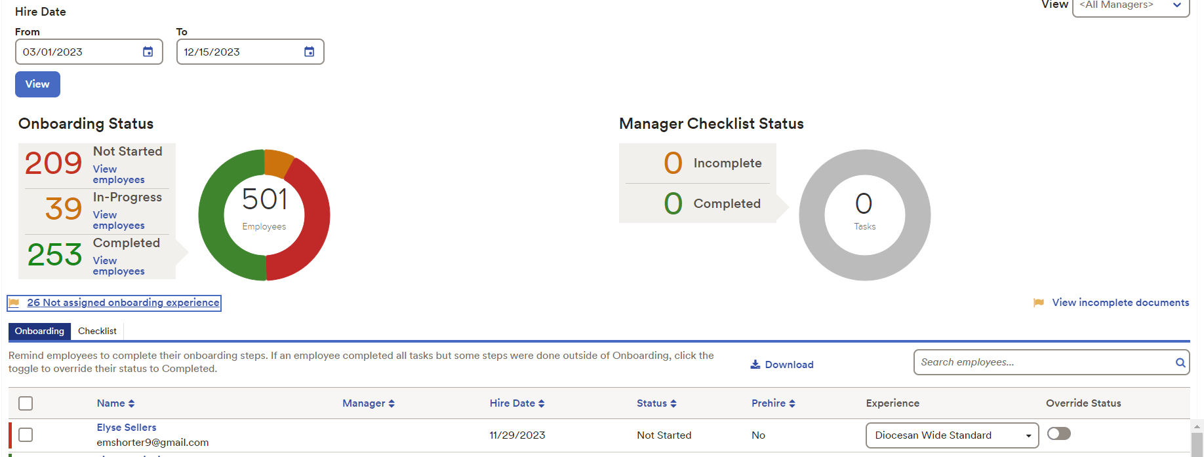
Onboarding Dashboard
Notes:
Once you get to the Onboarding Dashboard, it’s important that you change the date range to 1/1/23 to show employees hired throughout the entire year.
You’ll need to enter the date in the upper left-hand corner and select “view”.
As a heads up, the system will take a moment to process after you click the “view” button.
After that, you’ll see the onboarding status down in the section we circled. When the status says “not started”, it means that the employee has not completed any of the onboarding tasks, including the I-9.

Slide 13
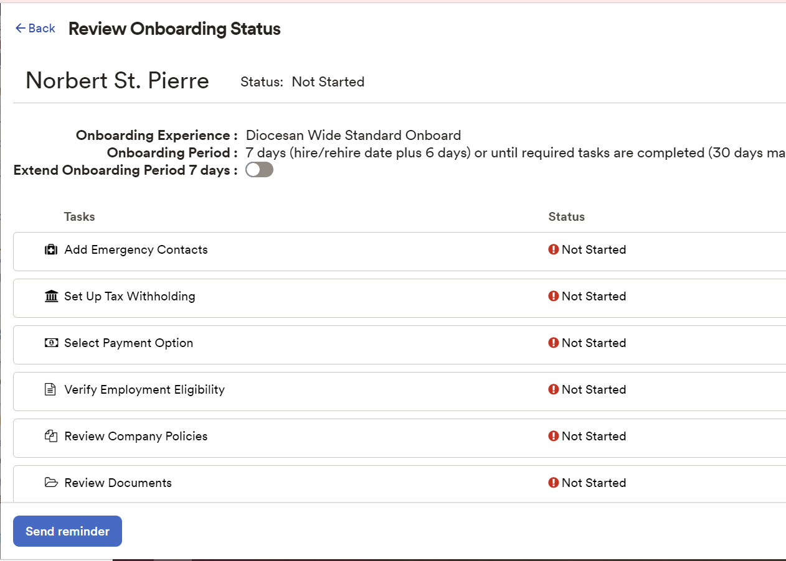
Extending Onboarding
1.
2.
Notes:
To extend onboarding, you’ll need to click on the employee’s name (as shown in step 1) and the toggle next to ‘Extend Onboarding for 7 Days (as shown in step 2).
The 7-day extension starts on the day that you press that button. After you do so, you will see a new due date populate next to the toggle button that you just clicked.
Once you do this, please tell your employee that they need to login to ADP and complete this task as soon as possible.

Slide 14
Potential Issues
Unable to extend onboarding – reach out to HR for assistance
Ensure you have the necessary identification to satisfy the I-9 so you can complete section 2
Following-up with employees and sending out reminders
Notes:
Some other problems you may run into…
If you are unable to extend the onboarding experience, this likely means the employee was not assigned onboarding at the time of hire, and it will be tricky to complete this process now.
We ask that you complete all the steps you can, and then reach out to us about any you may struggle with.
If you still do not have the required identification to satisfy the person’s I-9, you also won’t be able to complete section 2.
If that’s the case, please get this documentation as soon as possible and follow up with them regularly so you can move forward with the process.

Slide 15
Best Practice for New Hires
New hire completes New Hire Information Collection Form
You enter new hire into ADP while they complete remaining paperwork and Safe Haven Training
Once you finish entering new hire, ask them to complete Section 1 of I-9
You will complete Section 2 of the I-9 and E-Verify them while still present
Notes:
Now we’ll go over what we recommend for best practice.
We know it can seem overwhelming to get employees E-Verified by their 3rd day.
But, we have found it is extremely helpful and fool-proof to complete the entire I-9 and E-Verify process while the employee completes their new hire paperwork and Safe Haven Training.
After they are finished with the New Hire Collection Form, you can enter them into ADP as a new hire right then and there.
Once they are done with their paperwork and you have finished hiring them, you can give them the instructions I mentioned before to help them activate their ADP account and complete section one of the I-9.
Then, you can log back into your ADP account, complete section two, and submit Form I-9 form for E-Verification.
Then, if there are any issues with the documents, you have the employee there if you need more information from them and you still have a couple of days before the deadline to fix any errors.
If all goes well, a few seconds after you submit the complete Form I-9, you will receive an E-Verify confirmation, and the case will be closed.
The entire process should take less than 30 minutes to complete.

Slide 16
Final Items
Thank you for attending!
Questions?
Please reach out to Haley Ball at 843-261-0425 with questions you may have after today.
Notes:
We are hoping to complete all outstanding I-9 and E-Verifies before Christmas, so we are asking you to make a big push to focus on this task.
This is a critical issue because many of you have thousands, or tens of thousands of dollars of potential penalties outstanding as we speak.
Now finally, we know this is a lot of information and we really appreciate your time and attention.
Now, we will open up the floor for questions.

Slide 17
Login & Section One Instructions For Employee
Follow registration link in email from ADP or go to: https://workforcenow.adp.com/
Click get started towards the bottom of the screen
Click I have a registration code
Enter rcdoc-DOC1820
Click continue
Verify your information, create a password, and note the username provided
Log into ADP using the password you created and the username that ADP provided on the previous screen
After you get logged into ADP, you might see a pop-up about completing onboarding tasks, click the X at the top right of that pop-up
Click the dark blue get started button at the top right (start here if you have already activated your ADP account)
Click next at the bottom right
Click next again
Click Employment Verification on the left-hand side
Enter your demographic information
Sign electronically
Click done

Slide 18
Section One Pending
As you’ve likely gathered, section one is the employee portion of the I-9 form. If you see this status within the EI-9 Management screen, the employee still needs to complete section one, you need to complete section two, and then you need to submit the form for E-Verification.
You are legally required to E-Verify all employees within their 3rd day of hire.

Slide 19
Section Two Pending
This status means your employee has already completed their part of the process (section one). You may now complete the employer portion (section two) to verify the information entered and submit the I-9 for E-Verification. After you click submit, the E-Verification status will appear on the next screen.
The next slide provides a step-by-step process for completing section two and submitting the I-9 for E-Verification.
Again, the full E-Verify process must be completed within the third day of work.

Slide 20
Section Two Pending Cont.
Click the three dots under the actions column
Click continue
Click continue to section two
Verify the employee’s work location address and select a new address from the drop-down if needed
Select an overdue reason from the drop-down
Click next
Select the document provided from the drop-down(s)
Upload copies of the documents
Complete the photo matching questions
Click next
Verify that the information on the form matches the documents
Scroll all the way down to the bottom of the page
Check the box next to the acknowledgement paragraph
Enter your first name, last name, and job title
Click submit
The next screen will provide the E I-9 summary. Click on E-Verify to view the employment authorization status. The employee has been E-Verified if you see this status:

Slide 21
E-Verify Pending
This status indicates that both sections one and two have been completed. To complete the process, please review the document information, enter your name and job title, and click submit.
Please see the steps on the next slide to complete the process.

Slide 22
E-Verify Pending Cont.
Click the three dots in the actions column
Click continue
Click continue to section two
Verify that the location address matches your physical address
Select an overdue reason from the drop-down
Click next
Verify that the information on the form matches the employee’s documents. It’s very difficult to correct the form if anything is incorrect.
Click next
Verify the work location address again
Click next
Check the acknowledgement box
Enter your first name, last name, and job title
Click submit
The next screen may take a few minutes to load
ADP will let you know the status of the E-Verification case and what next steps, if any, you need to take. If you see a message that the employee has been E-Verified, you are all done

Slide 23
Paper Form
As of January 1st, 2023, paper I-9 forms are no longer permitted. If you accidentally chose paper form in ADP for anyone hired on or after 1/1/23, you must switch the form type from paper to electronic, ask the employee to complete section one, complete section two, and submit the information to E-Verify.
Please go to the next slide for a step-by-step process on how to change the status from paper to electronic.

Slide 24
How to Change Paper to Electronic
Click the three dots in the actions column
Click continue
Click on change paper to electronic
Click yes
The employee’s status will then update to electronic
Please start this presentation over to complete the E-Verification process

Slide 25
Onboarding Dashboard Add. Info.
Since the I-9 task is part of the onboarding experience in ADP, you can use the Onboarding Dashboard to check the completion status of section one of the I-9, send reminder emails, invite employees to register their ADP accounts, and grant extensions.
If an employee has been assigned an onboarding experience within their first 30 days but has not completed their I-9 within their first 45 days, you can grant them 7 extra days to complete the I-9.
To grant extensions, go to: Process > HR > HR Dashboard > View Onboarding Dashboard > Change ‘From’ Hire Date to further in the past > click ‘View’ > Click on the employee’s name > toggle the switch next to ‘Extend Onboarding Period 7 days’. From this same screen, you can send an onboarding reminder email to the employee.
Note: you will see employees at other locations on this screen. This screen does not contain PII.
If onboarding is not assigned within 30 days from their hire date, onboarding can never be assigned again.
Note: Onboarding is automatically assigned after hiring an employee via the Hire w/Onboarding and E I-9 template found under process > hire/rehire. With that template, you should not need to do anything to assign onboarding.

