Slide 1
For a Synodal Church: Communion, Participation,
and Mission
Diocese of Charleston

Slide 3
INTRODUCTION
Thank you so very much for coming; we will be praying together, discussing together and taking a survey today.
Let’s practice saying SYNOD and SYNODALITY (hard to say)
(Sin uhd a lity)
Synodality pronunciation: How to pronounce Synodality in English Paste in browser(forvo.com), click arrows twice, turn up speakers.

Slide 4
GATHERING PRAYER
Leader: Spirit of God, open our minds and hearts this day that we may truly understand your will as we journey together in this Synod. We ask this prayer in the name of the Father, Son and Holy Spirit.
Reader: The Word of GOD (Acts 2:1-11, 14-19)
A reading from the Acts of the Apostles
When the time for Pentecost was fulfilled,
they were all in one place together.
And suddenly there came from the sky
a noise like a strong driving wind,
and it filled the entire house in which they were.
Then there appeared to them tongues as of fire,
which parted and came to rest on each one of them.
And they were all filled with the Holy Spirit
and began to speak in different tongues,
as the Spirit enabled them to proclaim.

Slide 5
Now there were devout Jews from every nation under heaven
staying in Jerusalem.
At this sound, they gathered in a large crowd,
but they were confused
because each one heard them speaking in his own language.
They were astounded, and in amazement they asked,
“Are not all these people who are speaking Galileans?
Then how does each of us hear them in his native language?
We are Parthians, Medes, and Elamites,
inhabitants of Mesopotamia, Judea and Cappadocia,
Pontus and Asia, Phrygia and Pamphylia,
Egypt and the districts of Libya near Cyrene,
as well as travelers from Rome,
both Jews and converts to Judaism, Cretans and Arabs,
yet we hear them speaking in our own tongues
of the mighty acts of God.” The Word of the Lord.

Slide 6
Reflection/Discussion Questions at Tables
How have I experienced the power of the Holy Spirit in my life?
How did God call you and what is your call?
In what ways do I see the Holy Spirit working in my parish, campus ministry, religious congregation ?

Slide 7
Introduce the Synod Survey Statements:
On your smartphone, would you please go to sites below and answer the following questions. Try not to deliberate, and choose the answer that first comes to your mind, which is usually the most authentic way that you feel.
Hispanic:
https://charlestondiocese.org/synod2023/encuesta/
English:
https://charlestondiocese.org/synod2023/survey/

Slide 8
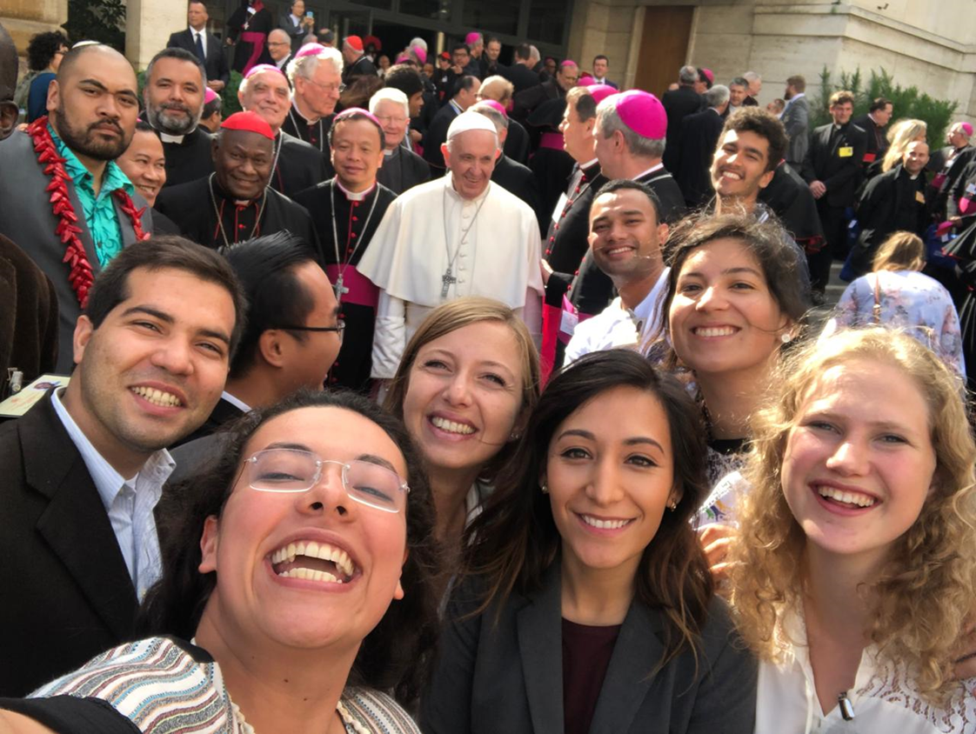
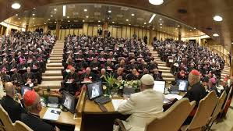
What is a Synod?
Established in 1965 by Pope Paul VI.
Periodic meetings of bishops.
The synod is convoked by the pope with the
intention of assisting him in church governance
and of demonstrating the responsibility of bishops as a body for the
universal church in addition to their individual responsibility in their
respective dioceses.
Recent Synods
Amazon
Youth
Family
Decree on the Bishops’ Pastoral Office in the Church - Second Vatican Council

Slide 9
Synodality
Journeying together
Pope, bishops, clergy, religious, laity
People on the margins; poor, vulnerable, unchurched, former Catholics, other faiths, youth, young adults.
Pope Francis has called for the people of God and clergy to convene and work together to discern a vision for the future of the Church.
The Synod
"is intended to inspire people to dream about the church we are called to be, to make people's hopes flourish, to stimulate trust, to bind up wounds, to weave new and deeper relationships, to learn from one another, to build bridges, to enlighten minds, warm hearts, and restore strength to our hands for our common mission.”
Synod Handbook

Slide 10
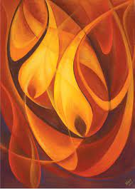
Synodality
is the way of being the Church today
according to the will of God,
in a dynamic of discerning
and listening together
to the voice
of the Holy Spirit.

Slide 11
The Synodal Conversion of the Church
Putting into practice the Synodal nature of the entire Church
Pope Francis sees this as a “Conversion Process”, a change
in how we do things
Collaboration, Listening, Creating ways to move the Church forward together
Journeying together

Slide 12
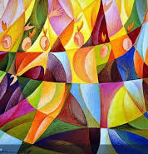
Synod Fundamental Questions:
A synodal Church, in announcing the Gospel, “journeys together.”
How is this “journeying together” happening today in your local Church?
What steps does the Spirit invite us to take in order to grow in our “journeying together”? (PD, 26)

Slide 13
We are invited to
Recall our experiences: What experiences of our local Church does this question call to mind?
Re-read these experiences in greater depth: What joys did they bring? What difficulties and obstacles have they encountered? What wounds did they reveal? What insights have they elicited?
Gather the fruits to share: Where in these experiences does the voice of the Holy Spirit resound? What is the Spirit asking of us? What are the points to be confirmed, the prospects for change, the steps to be taken? How do we come to consensus? What paths are opening up for our local Church?

Slide 14
10 Key Elements to Discern
1. Companions on The Journey
2. Listening
3. Speaking Out
4. Celebration
5. Sharing Responsibility for Our Common Mission
6. Dialogue in Church and Society
7. Ecumenism
8. Authority and Participation
9. Discerning and Deciding
10.Forming Ourselves in Synodality

Slide 15
Regarding Table Discussion: Please, coordinators of the event, ask table facilitators to read the six principles for table discussion now…
For Online go to: https://charlestondiocese.org/wp-content/uploads/2021/10/Guide-for-Table-Sharing.pdf
At this time, table facilitators will introduce the questions to be discussed. Key: Each person is asked to share their responses, while not one person dominates the discussion. The scribe at each table uses their laptop or hardcopy to jot main points for each question. Hardcopy is listed first; online after. If using a hardcopy, please transfer your answers to the on-line version of the table-discussions questions.
English & Spanish
https://charlestondiocese.org/synod2023/table-discussions-questions-feedback/

Slide 16
Vatican Timeline

Slide 17
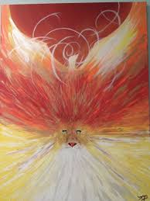
Diocese of Charleston(DRAFT)
Sept./Oct, | November | December | November – January 15,2022 | March | April 1, 2022
Reading and Preparation Website Begun Vatican Synod Mass Opening October 7 Charleston Synod Opening Mass October 17 | Discussion and Prayer Preparation for parishes and other groups |  | Listening Sessions throughout the diocese | Gather all information and synthesize | Send to USCCB
Creating Synod Leadership Teams | Training Facilitators already chosen in 25 parishes/religious/ campuses/young adults
Information to parishes and others | Information to parishes and others
Connecting with Catholic Charities, Religious, Colleges and Universities, more | Videos: Bishop’s Video Training facilitators (zoom) Facilitators to convene the listening sessions
Connecting with other dioceses

Slide 18
We stand before You, Holy Spirit, as we gather together in Your name. With You alone to guide us, make Yourself at home in our hearts; teach us the way we must go and how we are to pursue it. We are weak and sinful; do not let us promote disorder. Do not let ignorance lead us down the wrong path nor partiality influence our actions. Let us find in You our unity so that we may journey together to eternal life and not stray from the way of truth and what is right. All this we ask of You, who are at work in every place and time, in the communion of the Father and the Son, forever and ever. +Amen.
Official Prayer of the Synod:

